Slide 1
OR Scheduling Model
Caitlyn Barnwell and Michael Giannattasio

Slide 2
Background

Slide 3
Problem Overview
Problem: Hospital operating rooms (ORs) have various aspects that make their modeling much more complex than simple systems.
Importance: ORs are areas that are constantly being utilized and are the locations of many life-saving and necessary surgeries.
Scope: Identify variables that benefit the patient and hospitals running the ORs.
Project focuses on accounting for physical layout, staffing and equipment quantities, and OR scheduling optimization to best achieve success.

Slide 4

Problem Formulation Assumptions
Human assumptions (lack of sick days, consistent work effort, continued cooperation of patients, etc.):
Positive and negative impacts represented by variance
Data assumptions:
Rigorously checked and verified by simulators and OR staff to be accurate
Model assumptions:
Carefully developed and sufficiently complex model will give insight to the OR patient flow and provides enhanced decision-making capabilities
Optimal solution exists:
Current literature shows drastic improvements in OR performance based on implementation of staff and schedule optimization methods

Slide 5
Building the Model

Slide 6
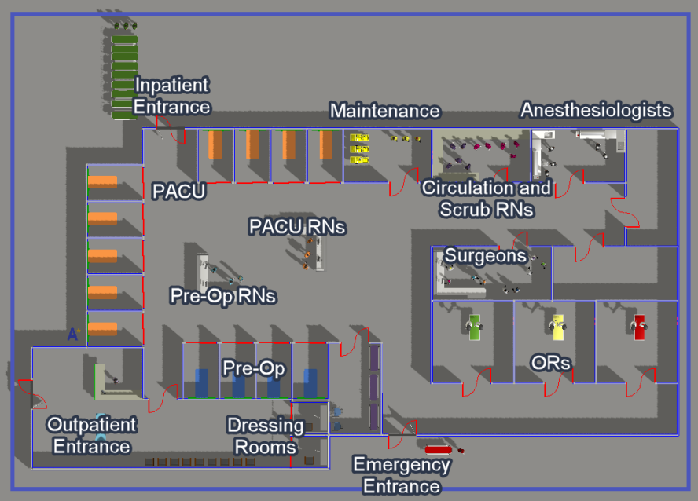
Model Layout
Main Aspects
9 PACU Beds
2 Dressing Rooms
4 Pre-Op Beds
3 Operating Rooms
Gurneys to more accurately simulate transporting patients into the hospital
Various stations for the staff on the floor

Slide 7
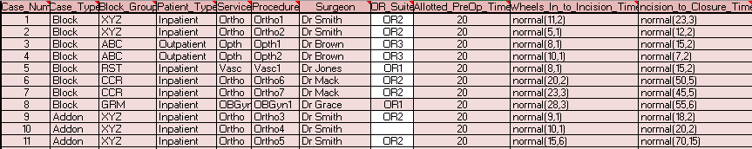
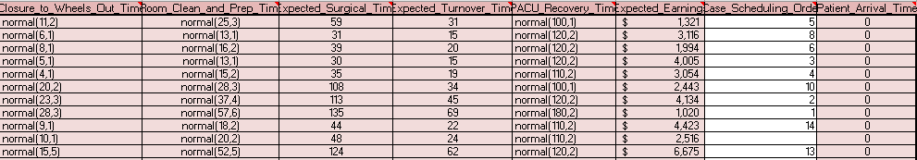
Excel Inputs for the Model
Unalterable Inputs:
Cells Shaded in Pink
Defining case information
Various time distributions and values for the case
Changeable Inputs:
Unshaded Cells
OR location
Scheduling order of the chosen cases

Slide 8
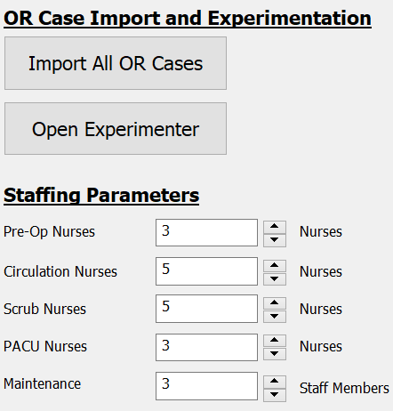
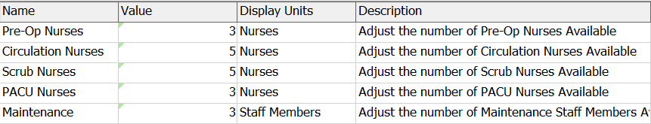
Parameter Creation
Staff parameter table created in the Toolbox
By creating parameters, the values can vary depending on the desired scenario
Values based on a reference to the corresponding created staff group
Pre-Op: 1-3 Nurses
Circulation: 2-5 Nurses
Scrub: 2-5 Nurses
PACU: 2-5 Nurses
Maintenance: 1-3 Nurses

Slide 9
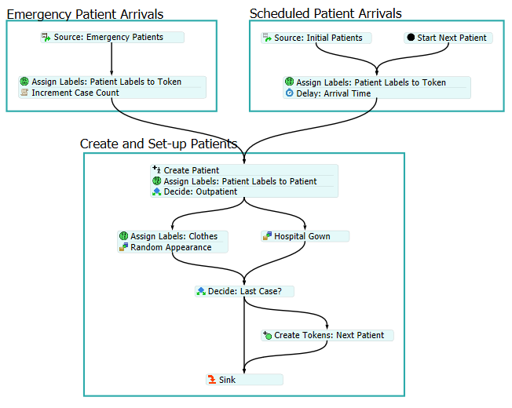
Model Overview: Arrivals
Two types of arrivals are created:
Emergency
Scheduled
Information pulled from Global Lookup Tables to create token labels.
Patient created and token labels used to assign values to the patient.
Hospital gowns or normal clothes assigned to patient depending on type.

Slide 10
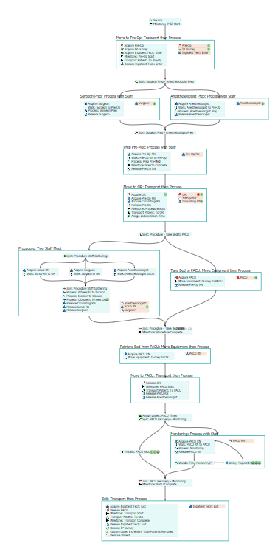
Model Overview: Inpatient Flow
Move to Pre-Op
Prep Surgeon and Anesthesiologist
Complete Pre-Op with RN
Move to OR
Move Bed to PACU while Procedure occurs
Pick-Up Patient and Move to PACU
Recover in PACU with Monitoring
Change and Escort to Exit

Slide 11
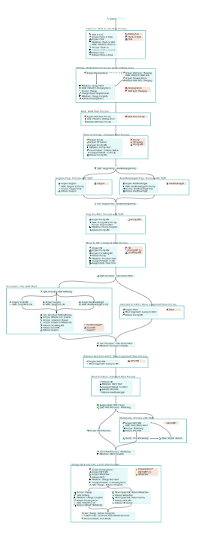
Model Overview: Outpatient Flow
Check-In
Change
Pre-Op Waiting Area
Pre-Op
Prep Surgeon and Anesthesiologist
Complete Pre-Op with RN
Move to OR
Move Bed to PACU while Procedure occurs
Pick-Up Patient and Move to PACU
Recovet in PACU with Monitoring
Change and Escort to Exit

Slide 12
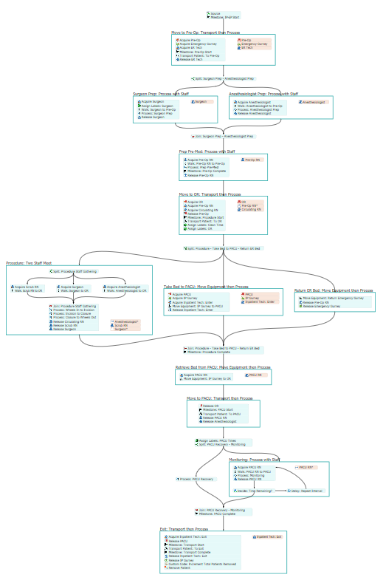
Model Overview: Emergency Surgery Patient Flow
Move to Pre-Op from Emergency Bed
Prep Surgeon and Anesthesiologist
Complete Pre-Op with RN
Move to OR
Move Bed to PACU while Procedure occurs
Return Emergency Bed
Pick-Up Patient and Move to PACU
Recovet in PACU with Monitoring
Change and Escort to Exit

Slide 13
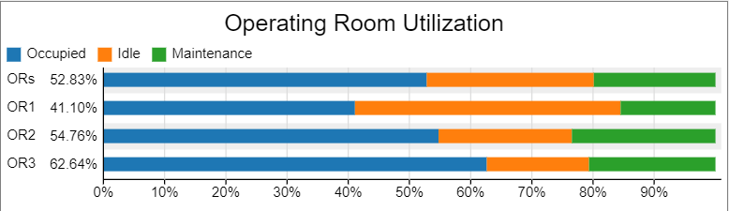
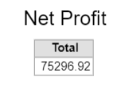
Dashboards & Performance Measures
OR Utilization:
Net Profit:
Average of all OR utilization
Computed Intrinsically in Model
Costs associated with employee count

Slide 14
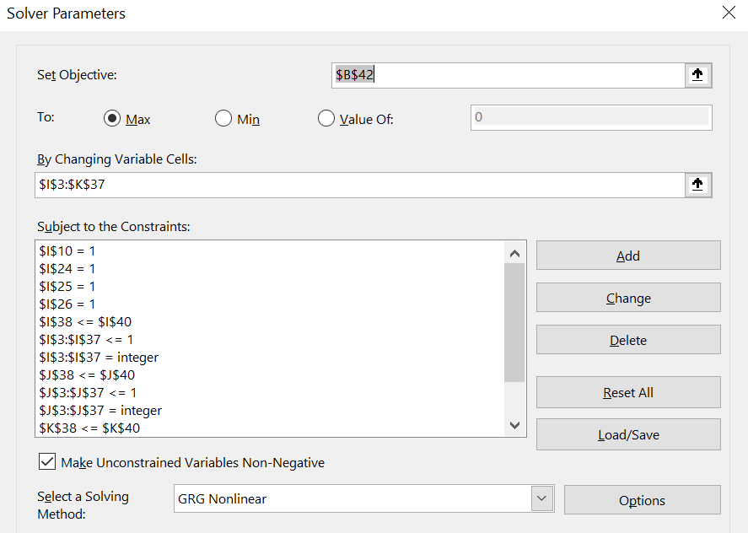

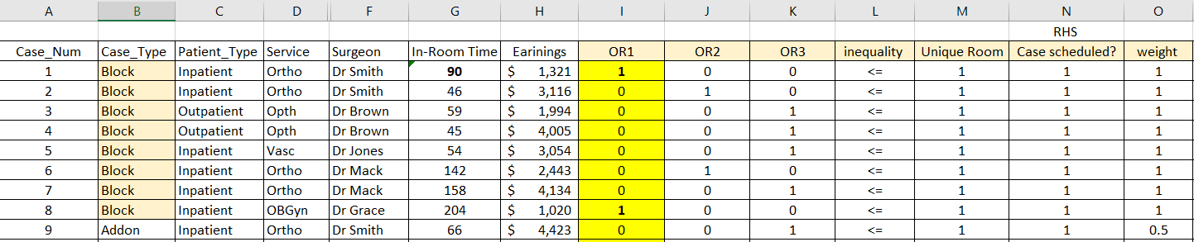
OR Scheduling Optimization in Excel

Slide 15
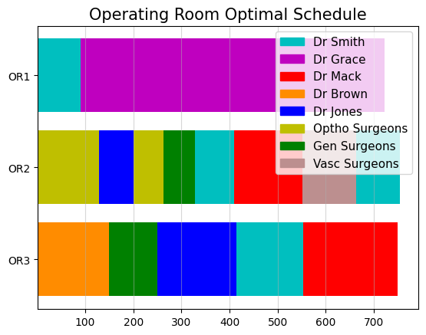
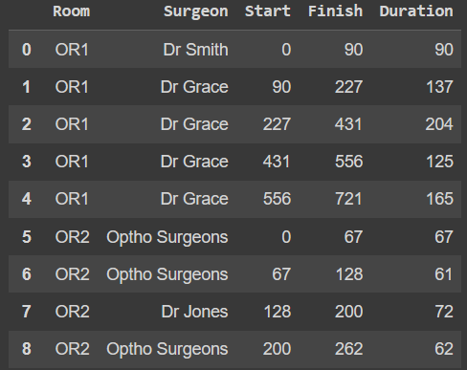
OR Scheduling Optimization in Python
Goal – ensure back-to-back scheduling
Format Data Properly
List[List of all Operations per Doctor [(room, operating time), … ], ...]
Define:
Makespan Objective
Disjunctive Constraints
Optimal Solution Found

Slide 16
Verification and Validation

Slide 17
Verification vs. Validation Methods
Verified by Expert Simulator
Verified by 2 Internal Simulators
Patient Flow Diagrams Work as Expected
Patient Animation Works as Expected
No Errors
High Face Validity
Structural Model Assumptions Valid
Different patient entrances
Patient flows for different patient types
Specific employee duties
Equipment available
Validated by FlexSim OR Expert Simulators

Slide 18
Experiments and Results

Slide 19
Key Performance Indicators (KPIs)
OR Utilization:
Percentage utilization of Operating Rooms
Represents efficiency
Net Profit:
Main business aspect
Allows higher reinvestment into hospital equipment
Factors in # of employees

Slide 20

Staffing Scenarios
Scenario 1 is the base staffing structure with all maximum staffing levels
Scenario 3 is a curated staffing selection based on the staff utilizations observed in testing the model
Aimed at estimating how many employees it would require in each category to make all staff-specific utilization rates higher.
Scenario 2 is the midpoint of the two
Computed using basic averaging

Slide 21
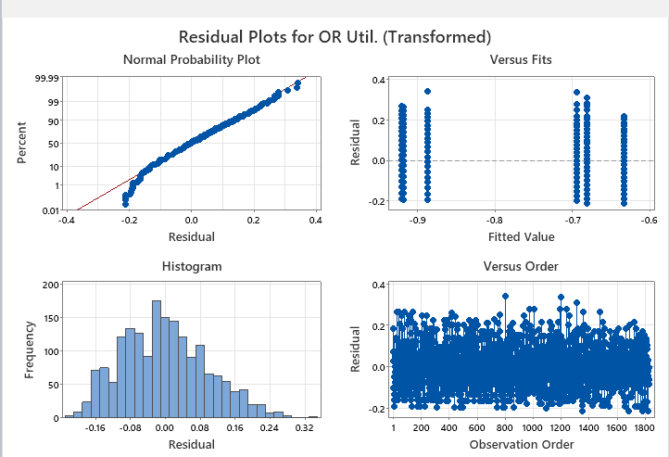
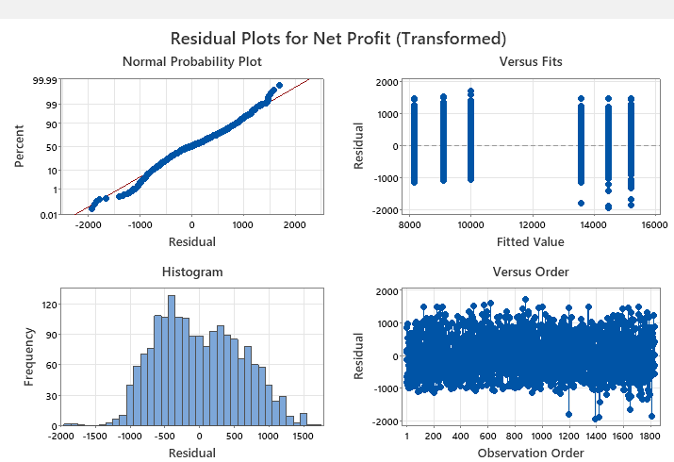
ANOVA Assumptions
Box-Cox transformation was applied to correct Q-Q plot tail behavior

Slide 22
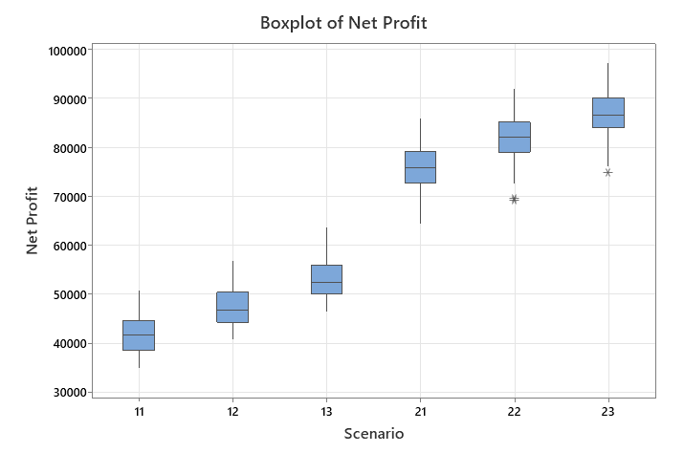
Net Profit Results
Note: 305 replications for adequate statistical power​

Slide 23
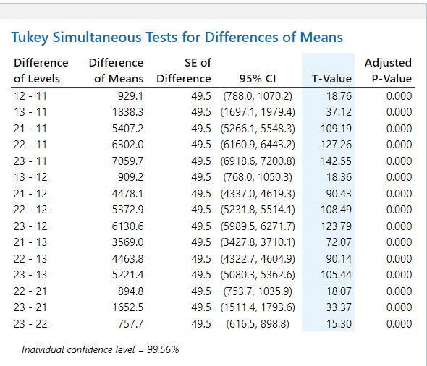
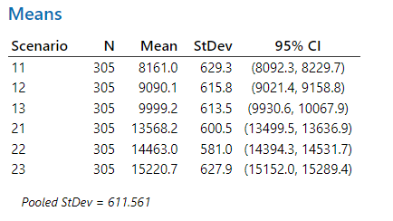
Net Profit Results
Note: 305 replications for adequate statistical power​

Slide 24
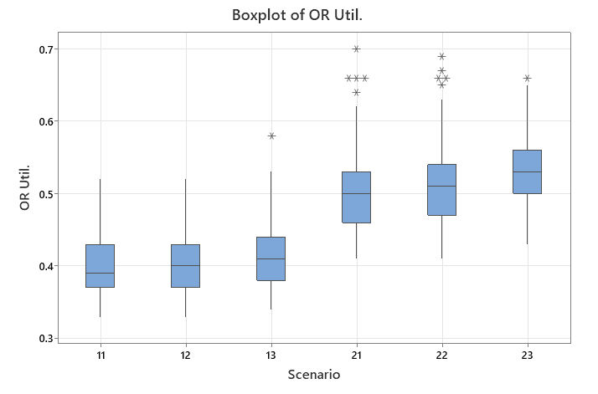
OR Utilization Results
Note: 305 replications for adequate statistical power​

Slide 25
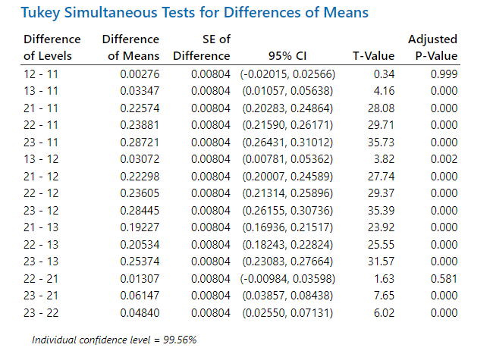
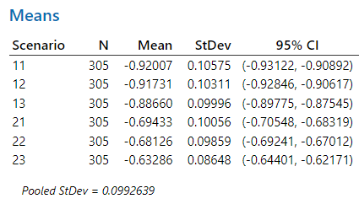
OR Utilization Results
Note: 305 replications for adequate statistical power​

Slide 26

Discussion of Results
Optimized Scheduling Results:
Significantly improved net profit and OR utilization across all scenarios
Optimal Solution:
Maximize net profit -> staffing scenario 3 with OR-scheduling optimized
Maximize OR utilization -> staffing scenario 2 with OR-scheduling optimized
No need for TOPSIS, universal winner

Slide 27

Literature Review and Future Improvements

Slide 28

Literature Review
Blocking minimization model for OR scheduling to minimize time in-between surgery blocks (Abedini et al., 2017).
Significant improvement over the base models
This could potentially be implemented to further increase scheduling optimization by considering different constraints in the solution
Robust optimization model based on the target max wait time for each patient’s acuity level (Maleki et al., 2023).
Low acuity patients do not wait for unreasonable amounts of time while high acuity patients are receiving treatment
Suggested improvement over the traditional deterministic method of mixed integer programming
While this task does not have patient acuities, the block vs. add-on represents a similar sort of patient acuity, so loosening the priority of block scheduling might result in increased OR-utilization rates

Slide 29
Literature Review
Understanding the metrics used to quantify operating room performance in literature such as throughput, utilization, and times (Schouten et al., 2023).
Heavy focuses on specific metrics results in unwanted sacrifices in other aspects
A more complex objective function could be developed to factor in multiple of these criteria in decision-making and find a more robust, long-term solution to the scheduling problem
MILP model for scheduling focused on optimizing with respect to 4 criteria (Marques et al., 2019):
Level the daily number of patients sent to each hospitalization unit
Concentrate surgeons from the same specialty as much as possible in the same room
Assign surgical specialties to OR time blocks when the maximum number of surgeons are available
Assign to each surgeon or surgical specialty an amount of OR time as close as possible to the median time used during the previous trimester
Apply a similar multi-objective approach to increase overall performance of the OR

Slide 30
Future Suggestions
Use different constraints and on differing criteria
Multi-objective optimization focus with robust objective functions
Factor in nuanced aspects of OR performance metrics
Experiment to select the ideal OR schedule
Determine the ideal solution with optimized scheduling

Slide 31
Questions?

Slide 32
References
Abedini, A., Li, W., & Ye, H. (2017). An Optimization Model for Operating Room Scheduling to Reduce Blocking Across the Perioperative Process. Procedia Manufacturing, 10, 60–70. https://doi.org/10.1016/j.promfg.2017.07.022
Maleki, A., Hosseininesaz, H., & Jasemi, M. (2023). A comparative analysis of the efficient operating room scheduling models using robust optimization and upper partial moment. Healthcare Analytics, 3, 100144. https://doi.org/10.1016/j.health.2023.100144
Marques, I., Captivo, M. E., & Barros, N. (2019). Optimizing the master surgery schedule in a private hospital. Operations Research for Health Care, 20, 11–24. https://doi.org/10.1016/j.orhc.2018.11.002
Schouten, A. M., Flipse, S. M., van Nieuwenhuizen, K. E., Jansen, F. W., van der Eijk, A. C., & van den Dobbelsteen, J. J. (2023). Operating Room Performance Optimization Metrics: A Systematic Review. Journal of Medical Systems, 47(1). https://doi.org/10.1007/s10916-023-01912-9

